Slide 1
Theory of machines Wessam Al Azzawi
Introduction:
Definitions
Theory of Machines is defined as that branch of Engineering-science, which deals with the study of relative motion between the various parts of a machine, and forces which act on them. Theory of Machines has four branches:
      Kinematics It is that branch of Theory of Machines which deals with the relative motion between the various parts of the machines.
Dynamics. It is that branch of Theory of Machines which deals with the forces and their effects, while acting upon the machine parts in motion.
Kinetics. It is that branch of Theory of Machines which deals with the inertia forces which arise from the combined effect of the mass and motion of the machine parts.
Statics. It is that branch of Theory of Machines which deals with the forces and their effects while the machine parts are at rest. The mass of the parts is assumed to be negligible.

Slide 2
Theory of machines Wessam Al Azzawi
Introduction:
Definitions
Machine is a device that receives energy in some available form and utilises it to do some particular type of work
International System of Units (S.I. Units) Is the system of units where the fundamental units are meter (m), kilogram (kg) and second (s) respectively, and their derived units are:
Density (mass density) kg/m³
Force N (Newton)
Pressure Pa (Pascal) or N/m² ( 1 Pa = 1 N/m²)
Work, energy (in Joules) 1 J = 1 N-m
Power (in watts) 1 W = 1 J/s
Absolute viscosity kg/m-s
Kinematic viscosity m²/s
Velocity m/s
Acceleration m/s²
Angular acceleration rad/s²
Frequency (in Hertz) Hz

Slide 3
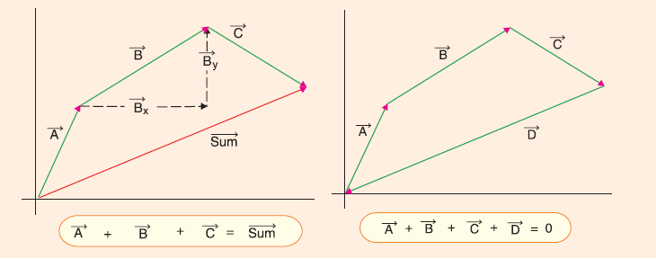
Theory of machines Wessam Al Azzawi
Introduction:
Definitions
Scalars and Vectors
Scalar quantities are those quantities, which have magnitude only, e.g. mass, time, volume, density etc.
Vector quantities are those quantities which have magnitude as well as direction e.g. velocity, acceleration, force etc.

Slide 4
Theory of machines Wessam Al Azzawi
Introduction:
Definitions
Representation of Vector Quantities
The vector quantities are represented by vectors. A vector is a straight line of a certain length possessing a starting point and a terminal point at which it carries an arrow head. The length of the vector represents the magnitude to some scale, and the arrow head of the vector represents the direction of the vector quantity.

Slide 5
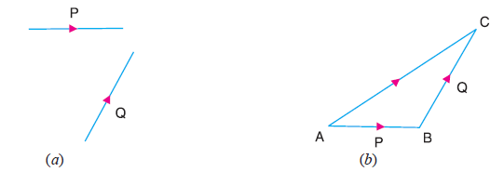
Theory of machines Wessam Al Azzawi
Introduction:
Definitions
Addition of Vectors
P and Q are required to be added. Take a point A and draw a line AB parallel and equal in magnitude to the vector P. Through B, draw BC parallel and equal in magnitude to the vector Q, AC will give the required sum of the two vectors P and Q.

Slide 6
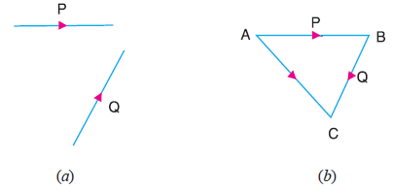
Theory of machines Wessam Al Azzawi
Introduction:
Definitions
Subtraction of Vector Quantities
Consider two vector quantities P and Q, difference is required to be found out. Take a point A and draw a line AB parallel and equal in magnitude to the vector P. Through B, draw BC parallel and equal in magnitude to the vector Q, but in opposite direction. AC gives the required difference.

Slide 7
Theory of machines Wessam Al Azzawi
Kinematics of Motion:
Kinematics of motion is the motion of bodies without consideration of the forces causing the motion.
Plane Motion
When the motion of a body is confined to only one plane, Rectilinear Motion
It is the simplest type of motion and is along a straight line path.
Curvilinear Motion
It is the motion along a curved path. Such a motion, when confined to one plane, is called plane curvilinear motion.

Slide 8
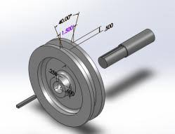
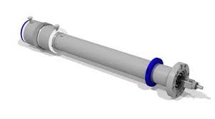
Theory of machines Wessam Al Azzawi
Kinematics of Motion:
Rotational motion
When all the particles of a body travel in concentric circular paths of constant radii (about the axis of rotation perpendicular to the plane of motion) such as a pulley rotating about a fixed shaft or a shaft rotating about its own axis, then the motion is said to be a plane rotational motion.

Slide 9
Theory of machines Wessam Al Azzawi
Kinematics of Motion:
Linear Displacement
Is the distance moved by a body with respect to a certain fixed point. It is a vector quantity has both magnitude and direction.
Linear Velocity
Is the rate of change of linear displacement with respect to the time (vector)
v = ds/dt
Linear Acceleration
Is the rate of change of linear velocity with respect to the time (vector)

Slide 10

Theory of machines Wessam Al Azzawi
Kinematics of Motion:
Equations of Linear Motion
v = u + a.t
s = u.t +1/2 a.t²
v² = u² + 2a.s
where u = Initial velocity of the body,
v = Final velocity of the body,
a = Acceleration of the body,
s = Displacement of the body in time t seconds, and
v_{av} = Average velocity of the body during the motion.

Slide 11
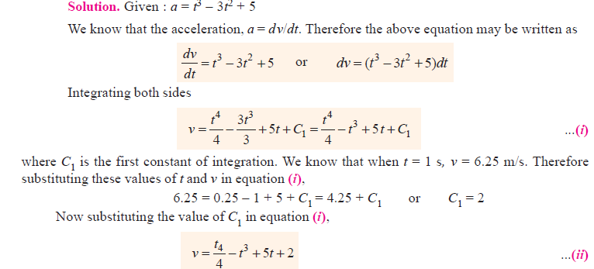
Theory of machines Wessam Al Azzawi
Kinematics of Motion:
Example.1 : The motion of a particle is given by a = t³ – 3t² + 5, where a is the acceleration in m/s² and t is the time in seconds. The velocity of the particle at t = 1 second is 6.25 m/s, and the displacement is 8.30 metres. Calculate the displacement and the velocity at t = 2 seconds.

Slide 12
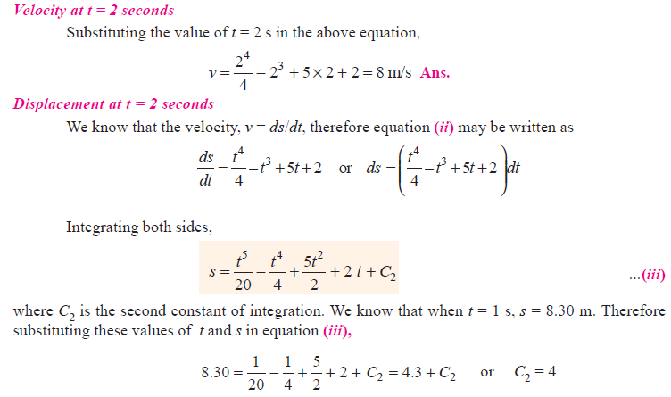
Theory of machines Wessam Al Azzawi
Kinematics of Motion:

Slide 13
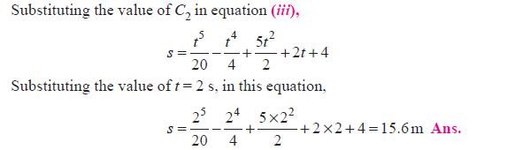
Theory of machines Wessam Al Azzawi
Kinematics of Motion:

Slide 14
Theory of machines Wessam Al Azzawi
Kinematics of Motion:
Example.1 : A car starts from rest and accelerates uniformly to a speed of 72 km/h over a distance of 500 m. Calculate the acceleration and the time taken to attain the speed. If a further acceleration raises the speed to 90 km/h in 10 seconds, find this acceleration and the further distance moved. The brakes are now applied to bring the car to rest under uniform retardation in 5 seconds. Find the distance travelled during braking.
Solution: Given : u = 0 ; v = 72 km/h = 20 m/s ; s = 500 m
Let a = Acceleration of the car.
We know that v² = u² + 2 a.s
∴ (20)2 = 0 + 2a × 500 = 1000 a or a = (20)2/ 1000 = 0.4 m/s² Ans.
Let t = Time taken by the car to attain the speed.
We know that v = u + a.t
∴ 20 = 0 + 0.4 × t or t = 20/0.4 = 50 s Ans.
Now consider the motion of the car from 72 km/h to 90 km/h in 10 seconds.
Given : * u = 72 km/h = 20 m/s ; v = 96 km/h = 25 m/s ; t = 10 s

Slide 15

Theory of machines Wessam Al Azzawi
Kinematics of Motion:
    Let a = Acceleration of the car.
    We know that v = u + a.t
    25 = 20 + a × 10 or a = (25 – 20)/10 = 0.5 m/s² Ans.
    Distance moved by the car
    We know that distance moved by the car,
    s = u.t + 1/2a.t² = 20×10 + ×1/2(10) ² = 225m Ans
    Now consider the motion of the car during the application of brakes for brining it to rest in 5 seconds.
    Given : *u = 25 m/s ; v = 0 ; t = 5 s
    We know that the distance travelled by the car during braking:

Slide 16
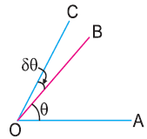
Theory of machines Wessam Al Azzawi
Kinematics of Motion:
Angular Displacement
It is the angle formed by a particle from one point to another, with respect to the time. For example, let a line OB has its inclination θ radians to the fixed line OA, as shown in Fig. If this line moves from OB to OC, through an angle δθ during a short interval of time δt, then δθ is known as the angular displacement of the line OB.
The angular displacement is a vector quantity.

Slide 17
Theory of machines Wessam Al Azzawi
Kinematics of Motion:
Representation of Angular Displacement by a Vector
Direction of the axis of rotation, It is fixed by drawing a line perpendicular to the plane of rotation, in which the angular displacement takes place.
Magnitude of angular displacement, It is fixed by the length of the vector drawn along the axis of rotation, to some suitable scale.
Sense of the angular displacement, It is fixed by a right hand screw rule. If a screw rotates in a fixed nut in a clockwise direction, and an observer is looking along the axis of rotation, then the arrow head will point away from the observer. Similarly, if the angular displacement is anti-clockwise, then the arrow head will point towards the observer.

Slide 18


Theory of machines Wessam Al Azzawi
Kinematics of Motion:
Angular velocity
It is the rate of change of angular displacement with respect to time, it is a vector quantity.
ω = dθ/ dt
Angular accelaration
It is the rate of change of angular velocity with respect to time. It is usually expressed by a Greek letter α (alpha)

Slide 19



Theory of machines Wessam Al Azzawi
Kinematics of Motion:
Equations of angular motion
The following equations of angular motion corresponding to linear motion :
ω0 = Initial angular velocity in rad/s,
ω = Final angular velocity in rad/s,
t = Time in seconds,
θ = Angular displacement in time t seconds
α = Angular acceleration in rad / s².

Slide 20
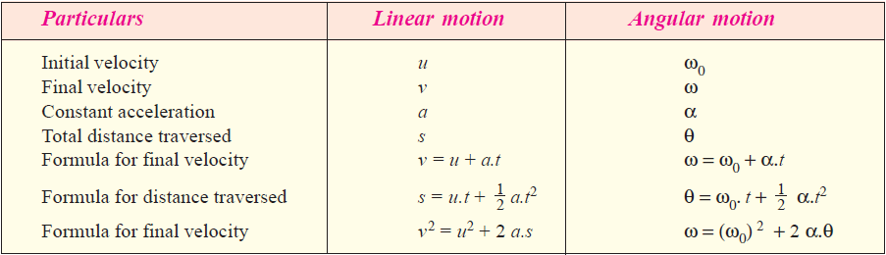
Theory of machines Wessam Al Azzawi
Kinematics of Motion:
Relation between Linear Motion and Angular Motion

Slide 21
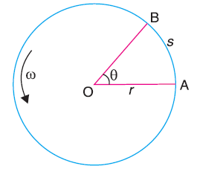


Theory of machines Wessam Al Azzawi
Kinematics of Motion:
Relation between Linear and Angular Quantities of Motion
Consider a body moving along a circular path from A to B as shown in the Fig.
Let r = Radius of the circular path,
θ = Angular displacement in radians,
s = Linear displacement,
v = Linear velocity,
ω = Angular velocity,
a = Linear acceleration
α = Angular acceleration.
s = r . θ
We also know that the linear velocity,
and the linear acceleration

Slide 22

Theory of machines Wessam Al Azzawi
Kinematics of Motion:
Example, A wheel accelerates uniformly from rest to 2000 r.p.m. in 20 seconds. What is its angular acceleration? How many revolutions does the wheel make in attaining the speed of 2000 r.p.m.?
Solution. Given : N₀ = 0 or ω = 0 ; N = 2000 r.p.m. or ω = 2π × 2000/60 = 209.5 rad/s ; t = 20s
Angular acceleration
Let α = Angular acceleration in rad/s².
We know that
ω = ω₀ + α.t or 209.5 = 0 + α × 20
∴ α = 209.5 / 20 = 10.475 rad/s² Ans.
We know that the angular distance moved by the wheel during 2000 r.p.m. (i.e. when ω = 209.5 rad/s),
Since the angular distance moved by the wheel during one revolution is 2π radians, therefore number of revolutions made by the wheel, n = θ /2π = 2095/2π = 333.4 Ans.

Slide 23
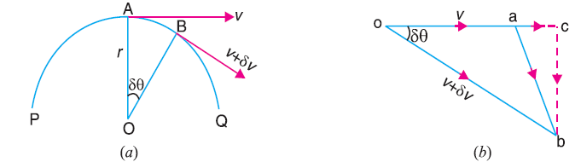
Theory of machines Wessam Al Azzawi
Kinematics of Motion:
Acceleration of a Particle along a Circular Path
Consider A and B, the two positions of a particle displaced through an angle δθ in time δt as shown in Fig.
r = Radius of curvature of the circular path,
v = Velocity of the particle at A, and
v + dv = Velocity of the particle at B.

Slide 24
Theory of machines Wessam Al Azzawi
Kinematics of Motion:
The change of velocity, as the particle moves from A to B may be obtained by drawing the vector triangle oab as shown in Fig.
In this triangle, oa represents the velocity v and ob represents the velocity v + dv. The change of velocity in time δt is represented by ab.
Resolve ab into two components, parallel and perpendicular to oa, ac and cb.
∴ ac = oc – oa = ob cos δθ – oa = (v + δv) cos δθ – v
and cb = ob sin δθ = (v + δv) sin δθ
Since the change of velocity of a particle (represented by vector ab) has two mutually perpendicular components, therefore the acceleration has the following two perpendicular components.

Slide 25


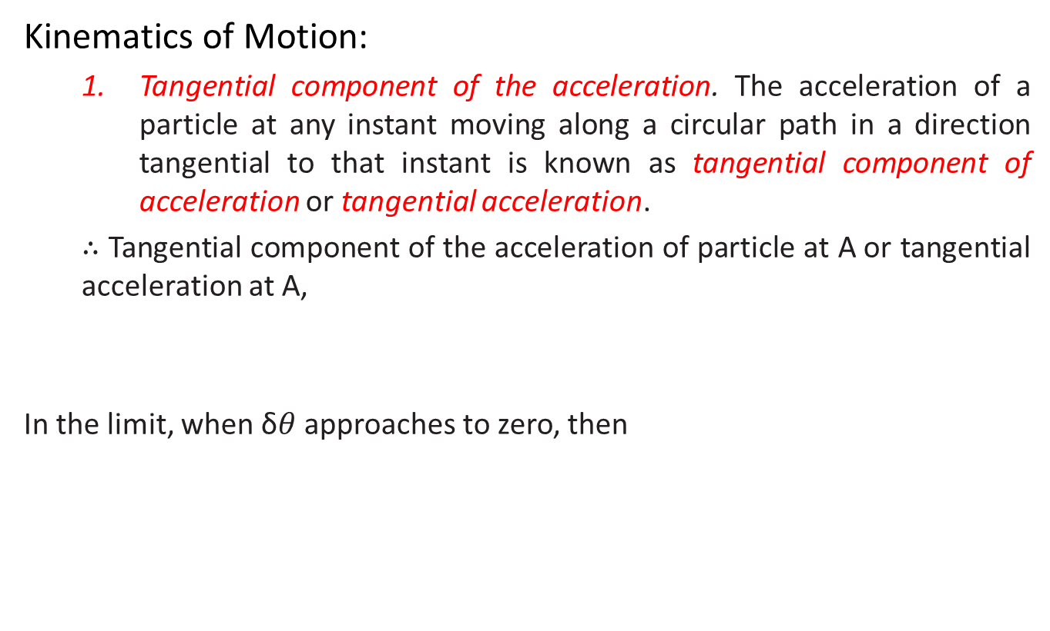
Theory of machines Wessam Al Azzawi
Kinematics of Motion:
Tangential component of the acceleration. The acceleration of a particle at any instant moving along a circular path in a direction tangential to that instant is known as tangential component of acceleration or tangential acceleration.
∴ Tangential component of the acceleration of particle at A or tangential acceleration at A,
In the limit, when δ$θ$ approaches to zero, then

Slide 26


Theory of machines Wessam Al Azzawi
Kinematics of Motion:
Normal component of the acceleration. The acceleration of a particle at any instant moving along a circular path in a direction normal to the tangent and directed towards the centre of the circular path is known as normal component of the acceleration or normal acceleration. It is also called radial or centripetal acceleration.
∴ Normal component of the acceleration of the particle at A or normal (or radial or centripetal) acceleration at A,
In the limit, when δt approaches to zero, then

Slide 27
Theory of machines Wessam Al Azzawi
Kinematics of Motion:
Example. A horizontal bar 1.5 metres long and of small cross-section rotates about vertical axis through one end. It accelerates uniformly from 1200 r.p.m. to 1500 r.p.m. in an interval of 5 seconds. What is the linear velocity at the beginning and end of the interval ? What are the normal and tangential components of the acceleration of the mid-point of the bar after 5 seconds after the acceleration begins ?
Solution. Given : r = 1.5 m ; N₀ = 1200 r.p.m. or ω₀ = 2 π × 1200/60 = 125.7 rad/s ; N = 1500 r.p.m. or ω = 2 π × 1500/60 = 157 rad/s ; t = 5 s
Linear velocity at the beginning
We know that linear velocity at the beginning,
v₀ = r . ω₀ = 1.5 × 125.7 = 188.6 m/s Ans.
Linear velocity at the end of 5 seconds
We also know that linear velocity after 5 seconds,
v₅ = r . ω = 1.5 × 157 = 235.5 m/s Ans.

Slide 28
Theory of machines Wessam Al Azzawi
Kinematics of Motion:
Tangential acceleration after 5 seconds
Let α = Constant angular acceleration.
We know that ω = ω₀+ α.t
157 = 125.7 + α × 5 or α = (157 – 125.7) /5 = 6.26 rad/s2
Radius corresponding to the middle point,
r = 1.5 /2 = 0.75 m
∴ Tangential acceleration = α. r = 6.26 × 0.75 = 4.7 m/s2 Ans.
Radial acceleration after 5 seconds
Radial acceleration = ω² . r = (157)² .0.75 = 18 487 m/s2 Ans.

